Slide 1

We Build To Make You Proud
Presentation
Guide to Google Analytics 4

Slide 2
Agenda
Introduction to GA4
Evolution of Google Analytics
Key Features of GA4
Benefits of GA4
How Does Google Analytics 4 Work?
Difference between GA4 vs UA
How to Migrate to Google Analytics 4

Slide 3

Introduction to GA4
Google Analytics 4 (GA4) is the latest version of Google's web analytics platform. It is designed to provide businesses and website owners with advanced insights into user behavior and improve their digital analytics capabilities.

Slide 4
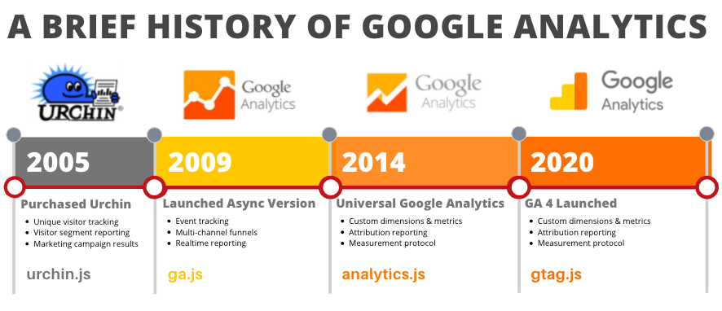
Evolution of Google Analytics

Slide 5
Key Features of GA4
> Event-based Data Collection - GA4 tracks user interactions as events, giving a flexible and comprehensive view of user behavior across websites and apps.
> Enhanced Cross-Platform Tracking: GA4 tracks user interactions on websites, mobile apps, and offline channels for a comprehensive understanding of the customer journey.
> Machine Learning-powered Insights: GA4 uses machine learning to reveal valuable insights and trends in data, helping businesses make data-driven decisions more effectively.
> Simplified User Interface: GA4 has a user-friendly interface that simplifies navigation, report analysis, custom tracking setup, and access to advanced analytics features.

Slide 6
Benefits of GA4
> Enhanced user journey tracking: Gain a better understanding of how users interact with your website and apps throughout their entire journey.
> Advanced insights and analytics: Uncover valuable trends and patterns in your data using advanced analytics techniques and machine learning.
> Improved cross-platform measurement: Track user interactions across multiple platforms, including websites, mobile apps, and more, for a comprehensive view of user behavior.
> Streamlined data visualization: Easily visualize and analyze your data with a user-friendly interface, making it simpler to derive meaningful insights.

Slide 7
How Does Google Analytics 4 Work?
> Data Collection - Data collection through tracking code installed on websites and mobile apps.
> Event-based Tracking - Event-based tracking captures specific user actions as events.
> User Identification - User identification using an anonymous identifier called the "User ID."
> Data Processing - Data processing and aggregation for generating insights.
> Analysis and Reporting - Analysis and reporting through a user-friendly interface.
> Machine Learning Integration - Integration of machine learning algorithms for trend detection and predictive insights.
> Integration with Google Marketing Platform - Seamless integration with other Google Marketing Platform products.

Slide 8
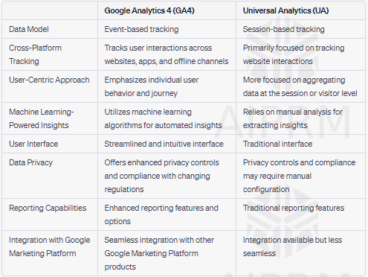
Difference between GA4 vs UA

Slide 9
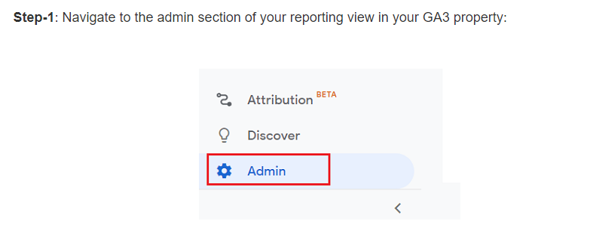
How to Migrate to Google Analytics 4

Slide 10
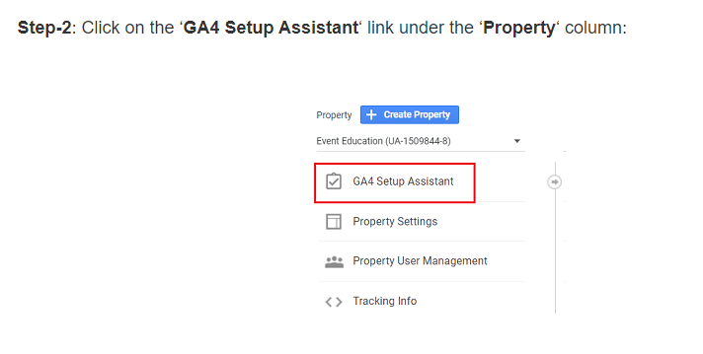
How to Migrate to Google Analytics 4

Slide 11
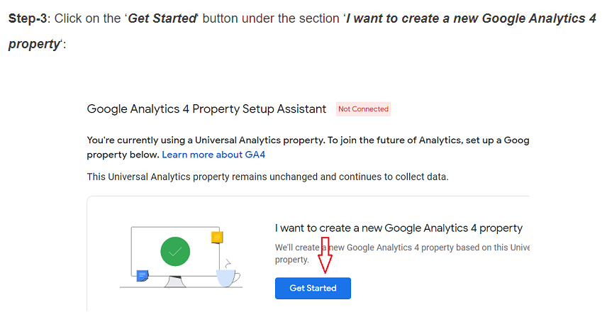
How to Migrate to Google Analytics 4

Slide 12
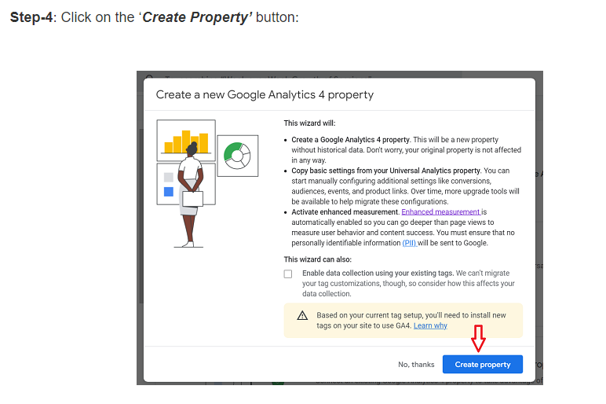
How to Migrate to Google Analytics 4

Slide 13
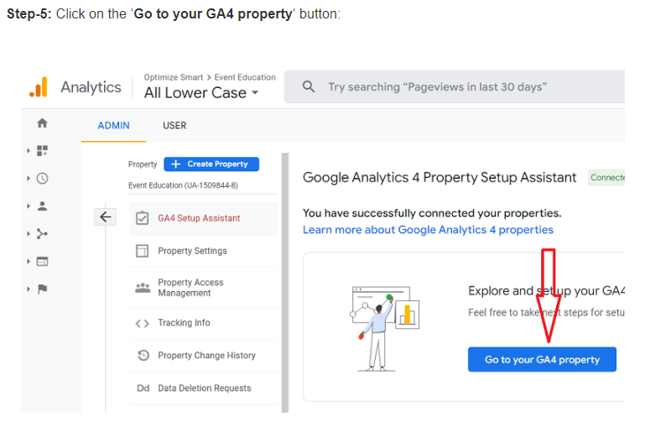
How to Migrate to Google Analytics 4

Slide 14
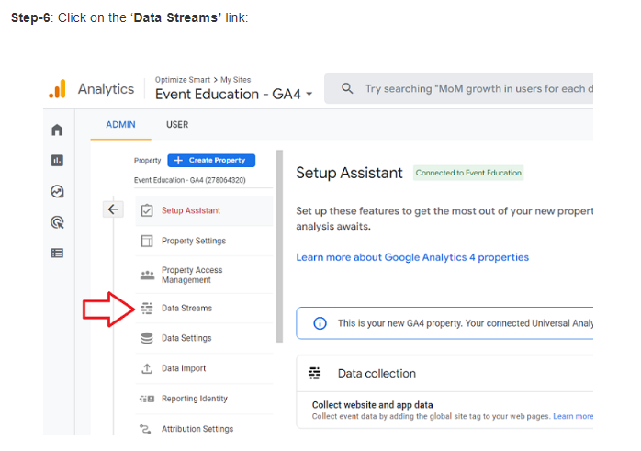
How to Migrate to Google Analytics 4

Slide 15
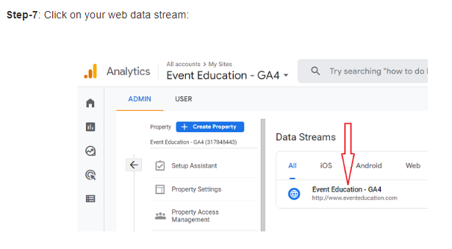
How to Migrate to Google Analytics 4

Slide 16
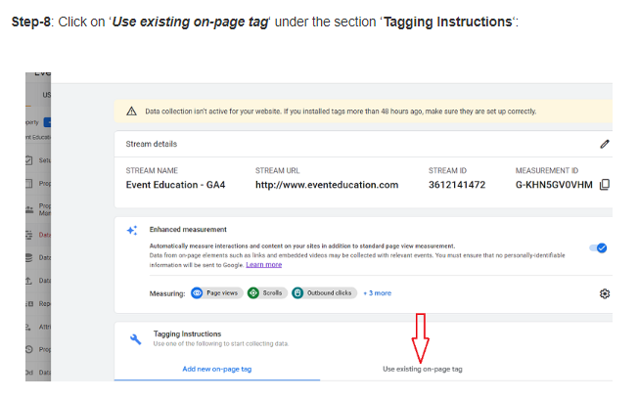
How to Migrate to Google Analytics 4

Slide 17
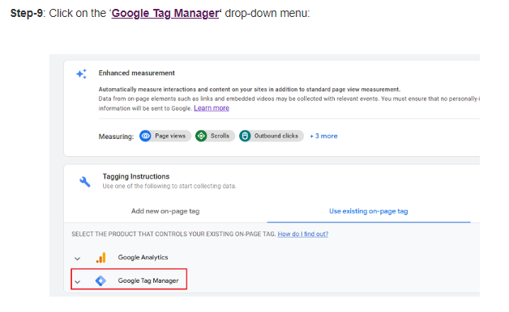
How to Migrate to Google Analytics 4

Slide 18
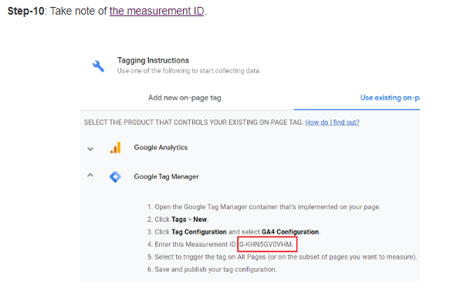
How to Migrate to Google Analytics 4

Slide 19
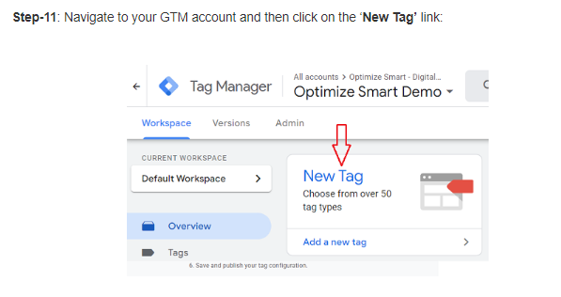
How to Migrate to Google Analytics 4

Slide 20
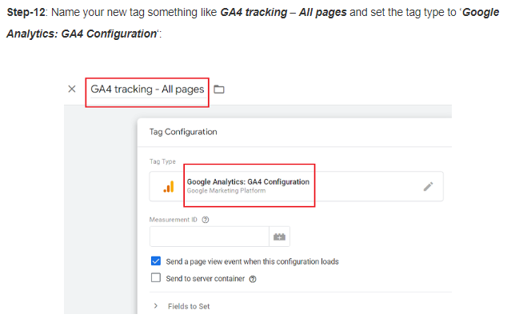
How to Migrate to Google Analytics 4

Slide 21
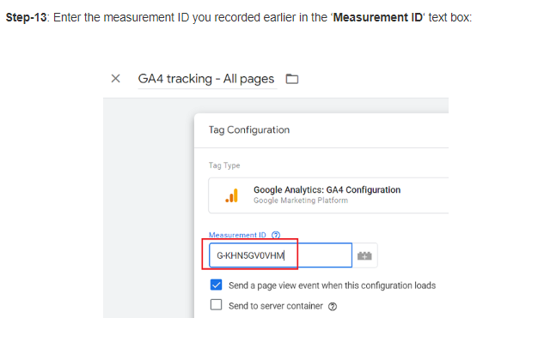
How to Migrate to Google Analytics 4

Slide 22
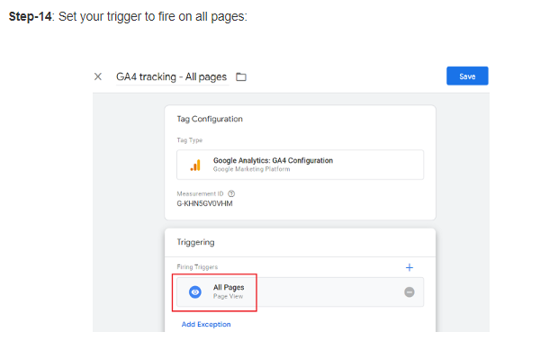
How to Migrate to Google Analytics 4

Slide 23
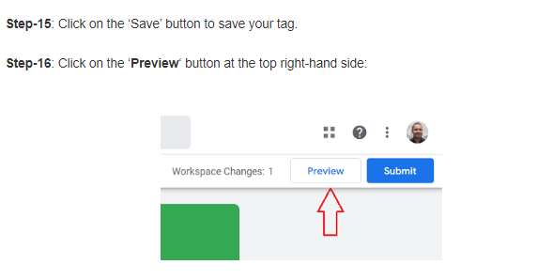
How to Migrate to Google Analytics 4

Slide 24
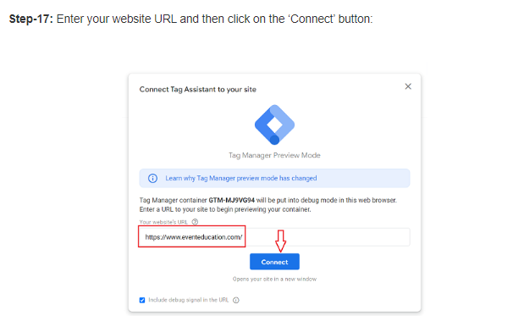
How to Migrate to Google Analytics 4

Slide 25
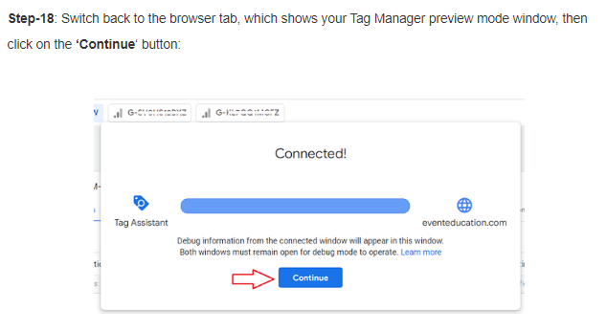
How to Migrate to Google Analytics 4

Slide 26
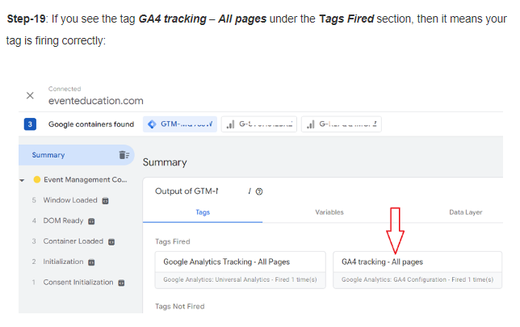
How to Migrate to Google Analytics 4

Slide 27
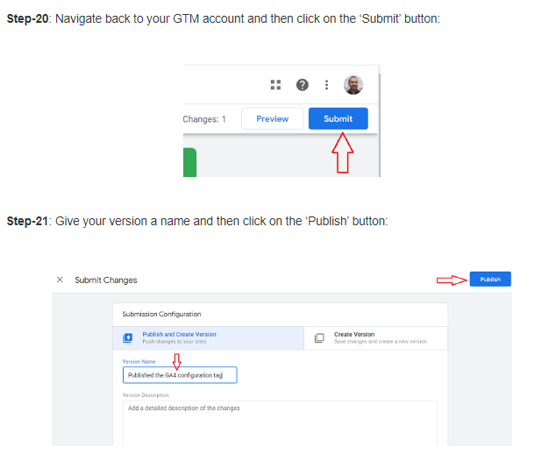
How to Migrate to Google Analytics 4

Slide 28
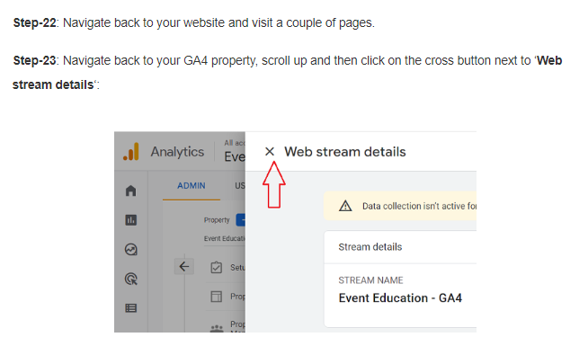
How to Migrate to Google Analytics 4

Slide 29
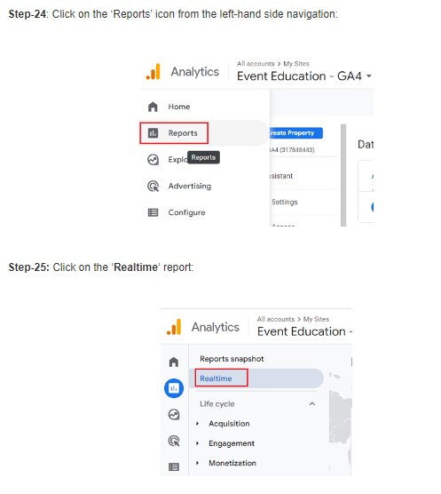
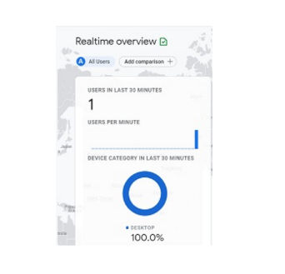
How to Migrate to Google Analytics 4

Slide 30
Event Creation in GA4

Slide 31
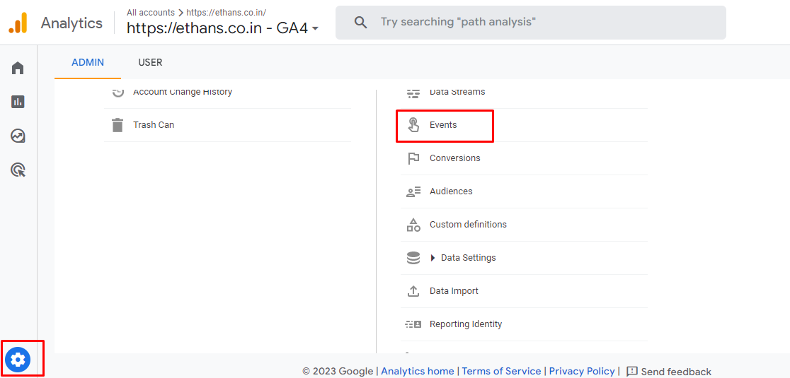
Creating an Event

Slide 32
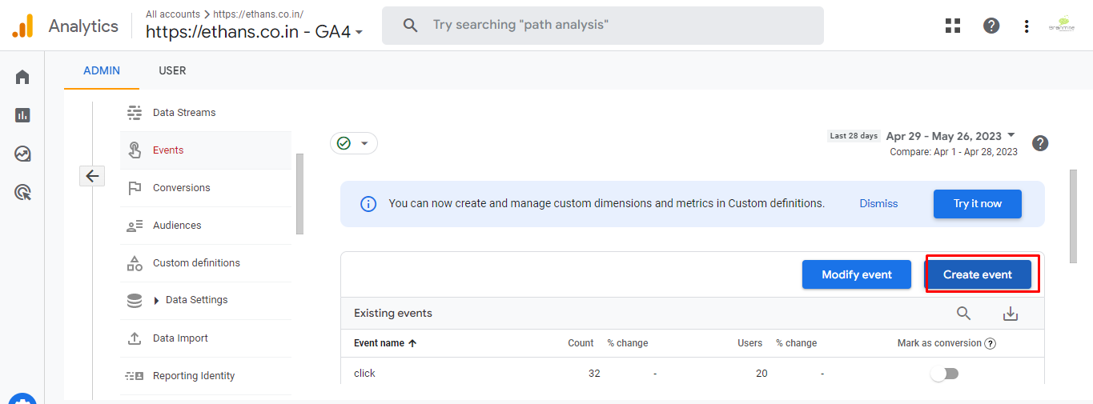
Creating an Event

Slide 33
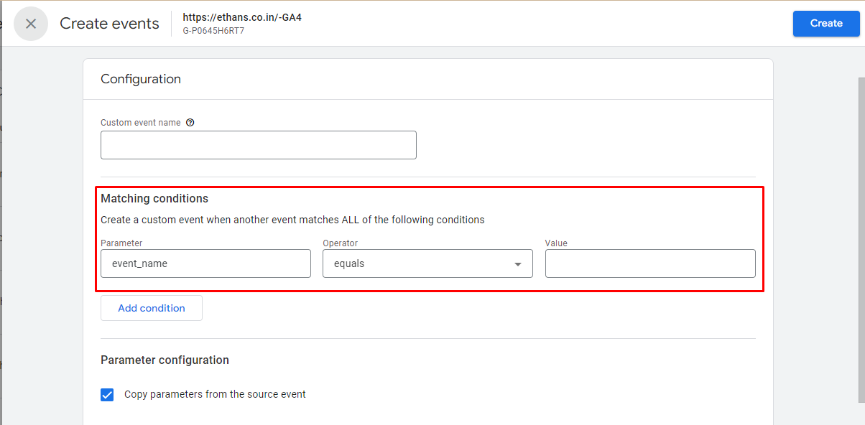
Creating an Event
To detect when users sign up, you could create a new event with the following Matching Conditions:
Parameter: event_name Operator: equals Value: page_view

Slide 34
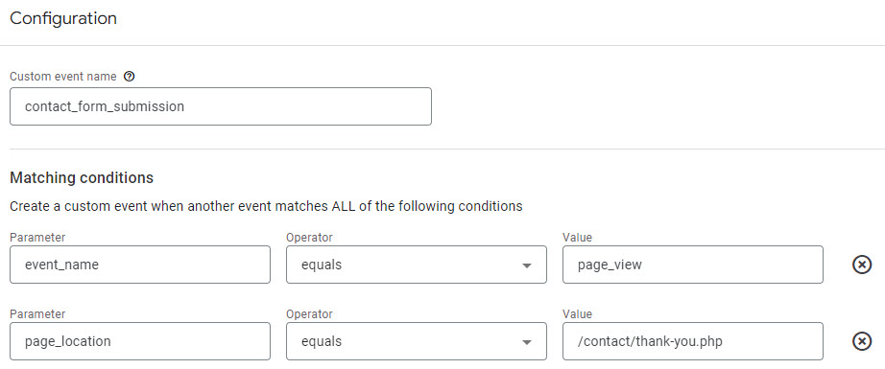
Creating an Event
Once this event is fired, it will appear in the events list, and you can mark it as a conversion.

Slide 35
Default Parameters
Along with the specific data collection mentioned above, GA4 sets several additional parameters for every event:
language – The preferred language of the user.
page_location – The URL of the page.
page_referrer – Where the user came from.
page_title – The HTML title of the page.
screen_resolution – The display resolution of the device being used.

Slide 36
Event Creation in GA-4 Using GTM

Slide 37
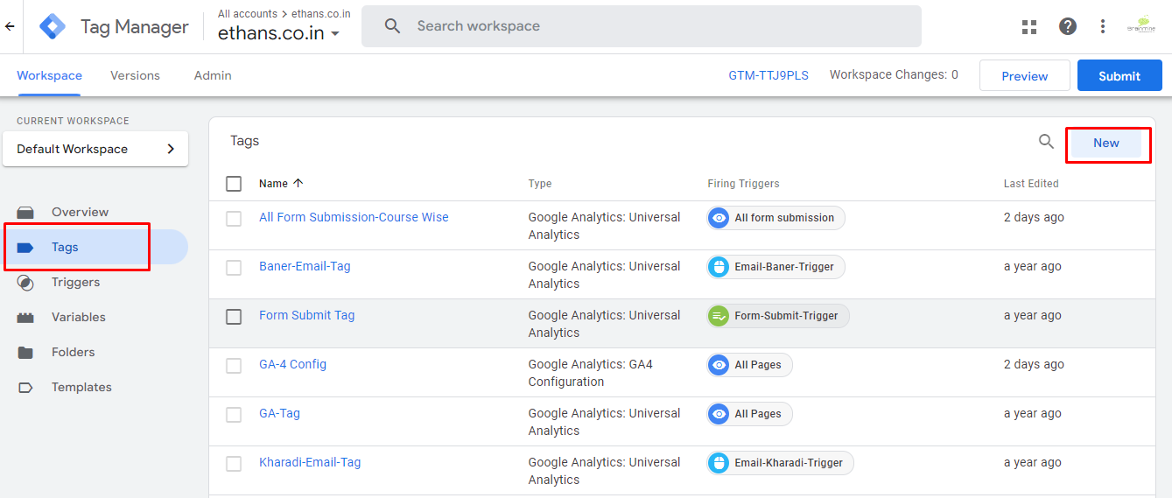
Custom GA4 Events In Google Tag Manager
1. Create a new tag in Google Tag Manager and select ‘GA4 Event’ as the tag type.

Slide 38
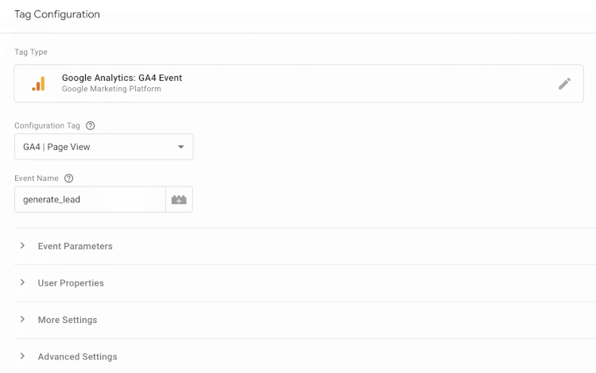
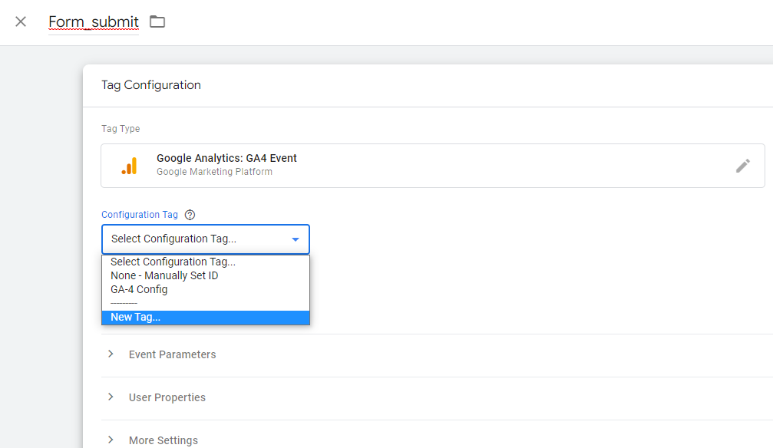
Custom GA4 Events In Google Tag Manager
2. Name your custom event. You can also include any optional parameters you want to use for reporting with the event.

Slide 39
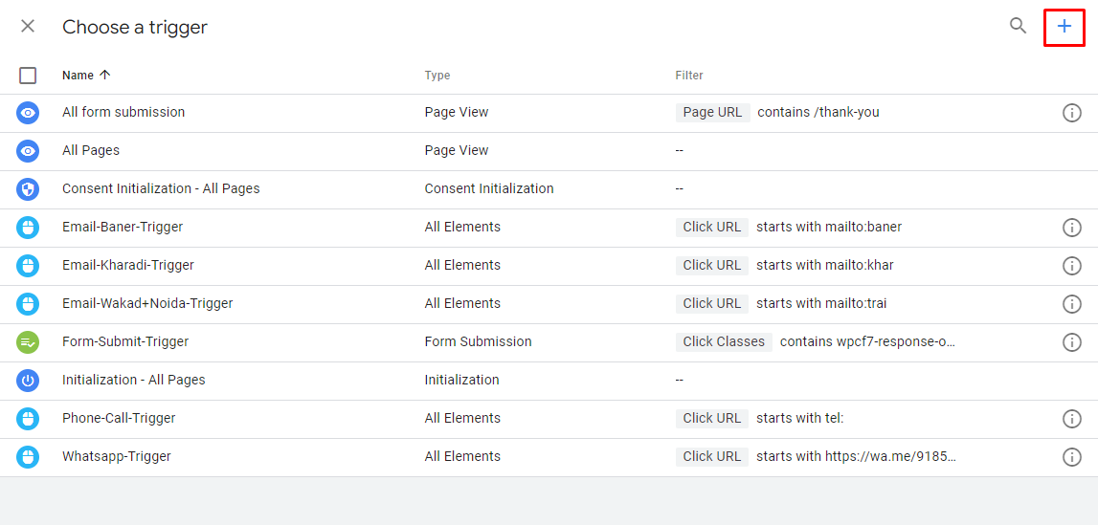
Create Trigger

Slide 40
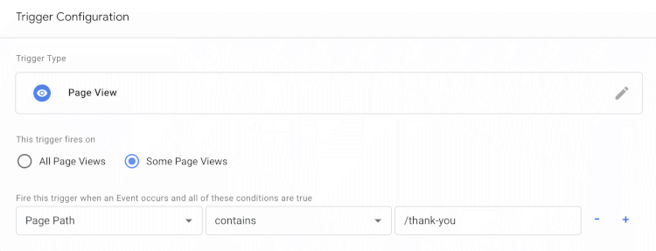
Select your existing GA4 configuration tag.
Create a trigger that will fire the tag when the action you want to track takes place on your website.
The following example will fire the tag when someone views a page on the website that includes ‘/thank-you’ in the URL:

Slide 41
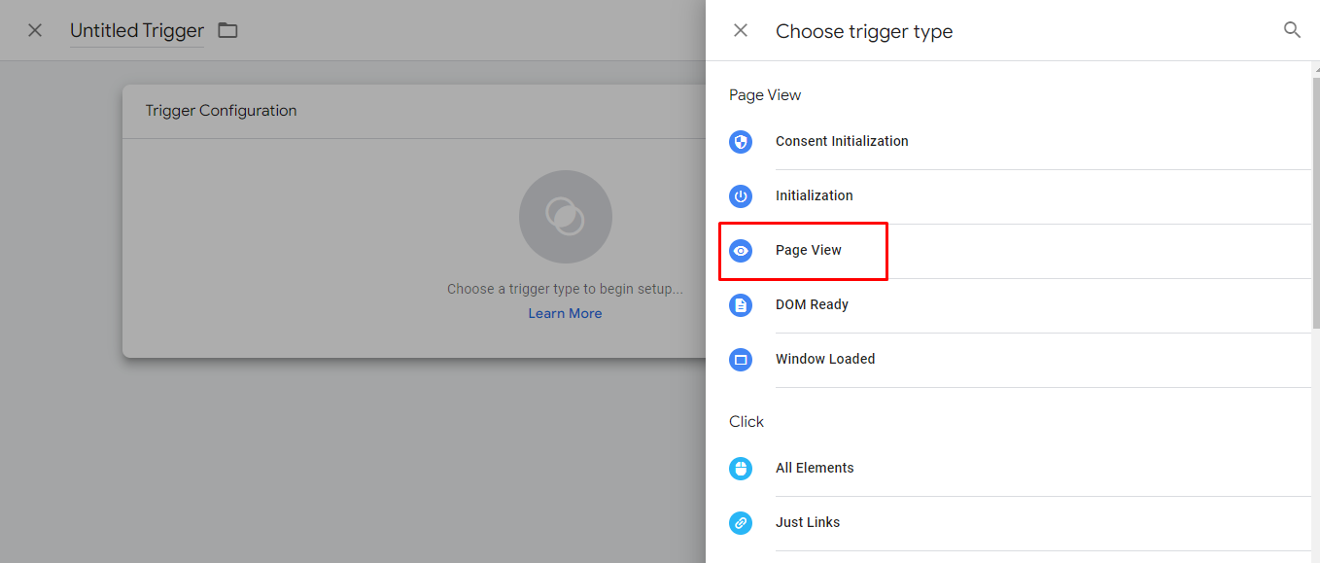
Choose Trigger

Slide 42
Choose Trigger

Slide 43
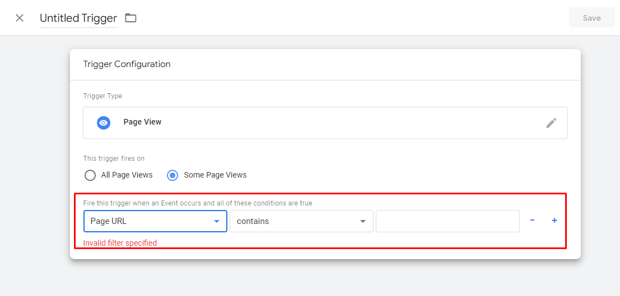
Trigger Configuration
Once the firing condition for the tag and trigger have been defined,
you can save both using a naming convention that makes it easy to differentiate in the future.

Slide 44
Trigger Configuration
Once the firing condition for the tag and trigger have been defined,
you can save both using a naming convention that makes it easy to differentiate in the future.

Slide 45
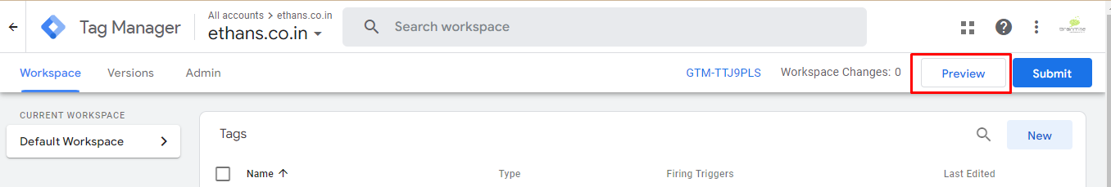
Tag Preview Using Tag Assistent
Verify if the tag is firing correctly by clicking on the "Preview" button at the top right corner of the page.
This will open a new window for Google Tag Assistant.

Slide 46
[UA→GA4] Goals migration

Slide 47
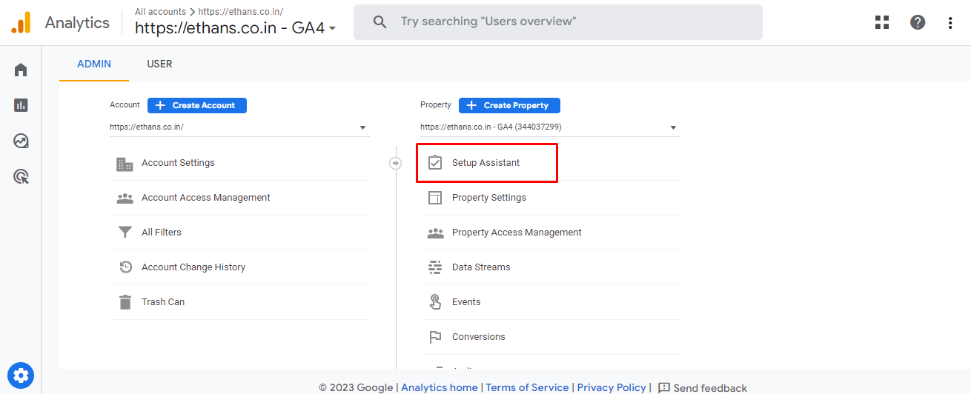
[UA→GA4] Goals migration
The goals migration tool allows you to quickly recreate eligible goals
from your connected Universal Analytics property as conversion events in your Google Analytics 4 property.

Slide 48
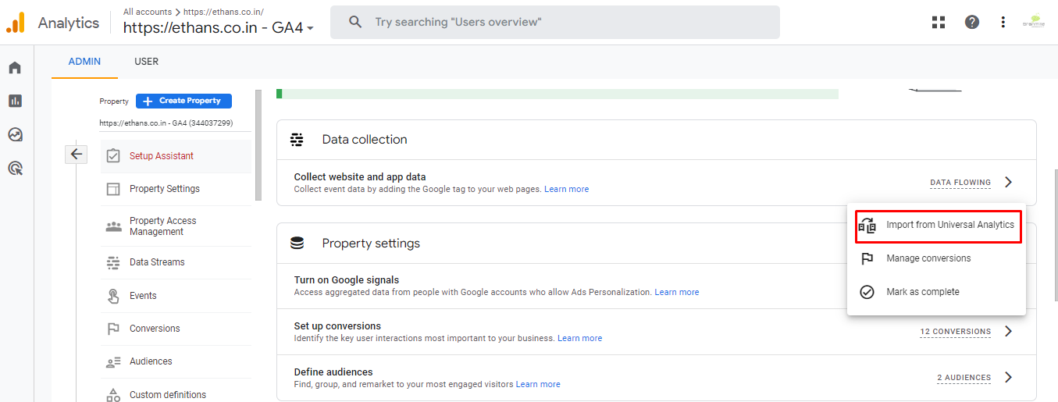
[UA→GA4] Goals migration
The goals migration tool allows you to quickly recreate eligible goals
from your connected Universal Analytics property as conversion events in your Google Analytics 4 property.

Slide 49

THANK YOU

